Slide 1
CEE 111 Engineering Drawing Lecture 2
Sheet layout
Title block
Lettering
Dimensioning

Slide 2
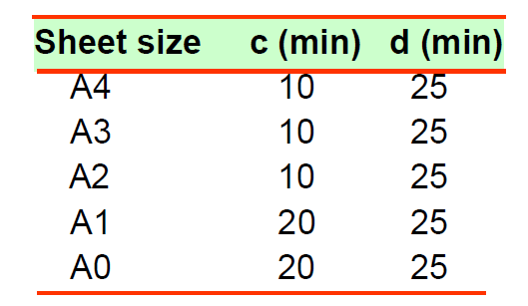
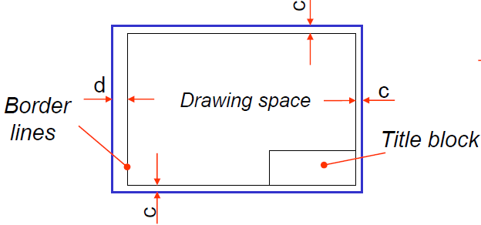
Sheet Layout
c = 10 mm
d = 25 mm

Slide 3
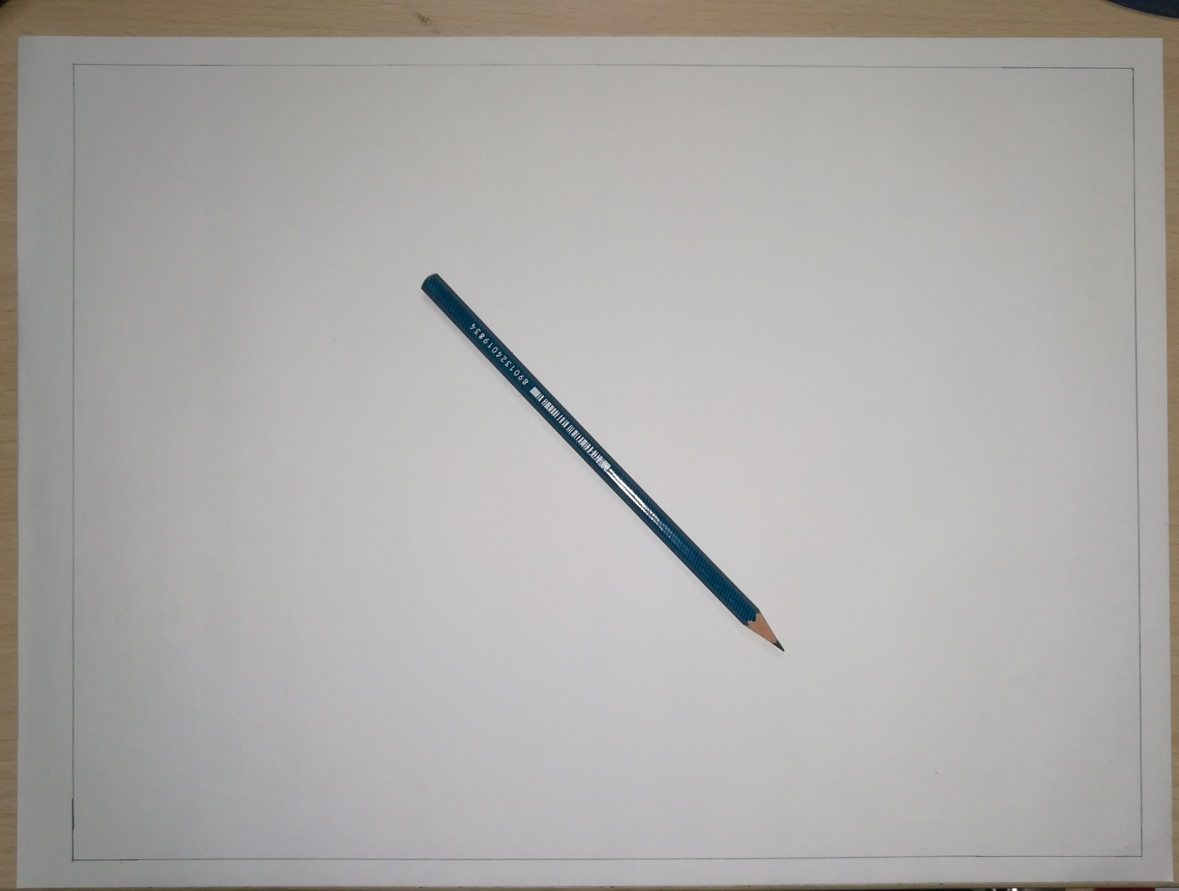
Sheet Layout
Border lines
Perpendicular to each other
Reference lines
10
25
10
10

Slide 4
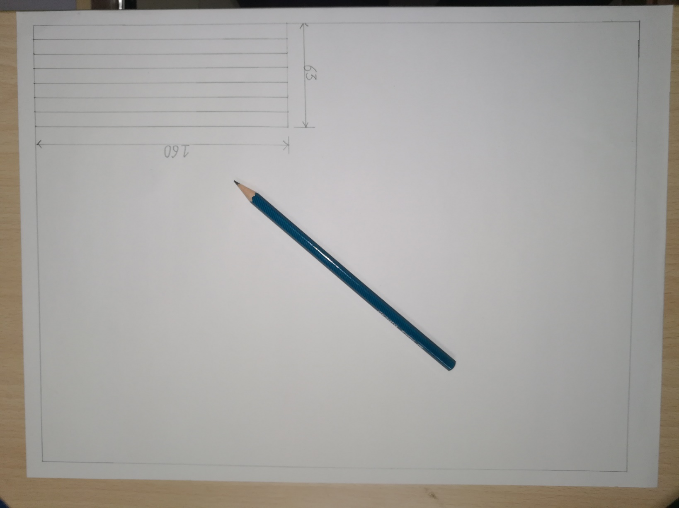
Sheet Layout
Title block
160 mm X 63 mm
160
63

Slide 5
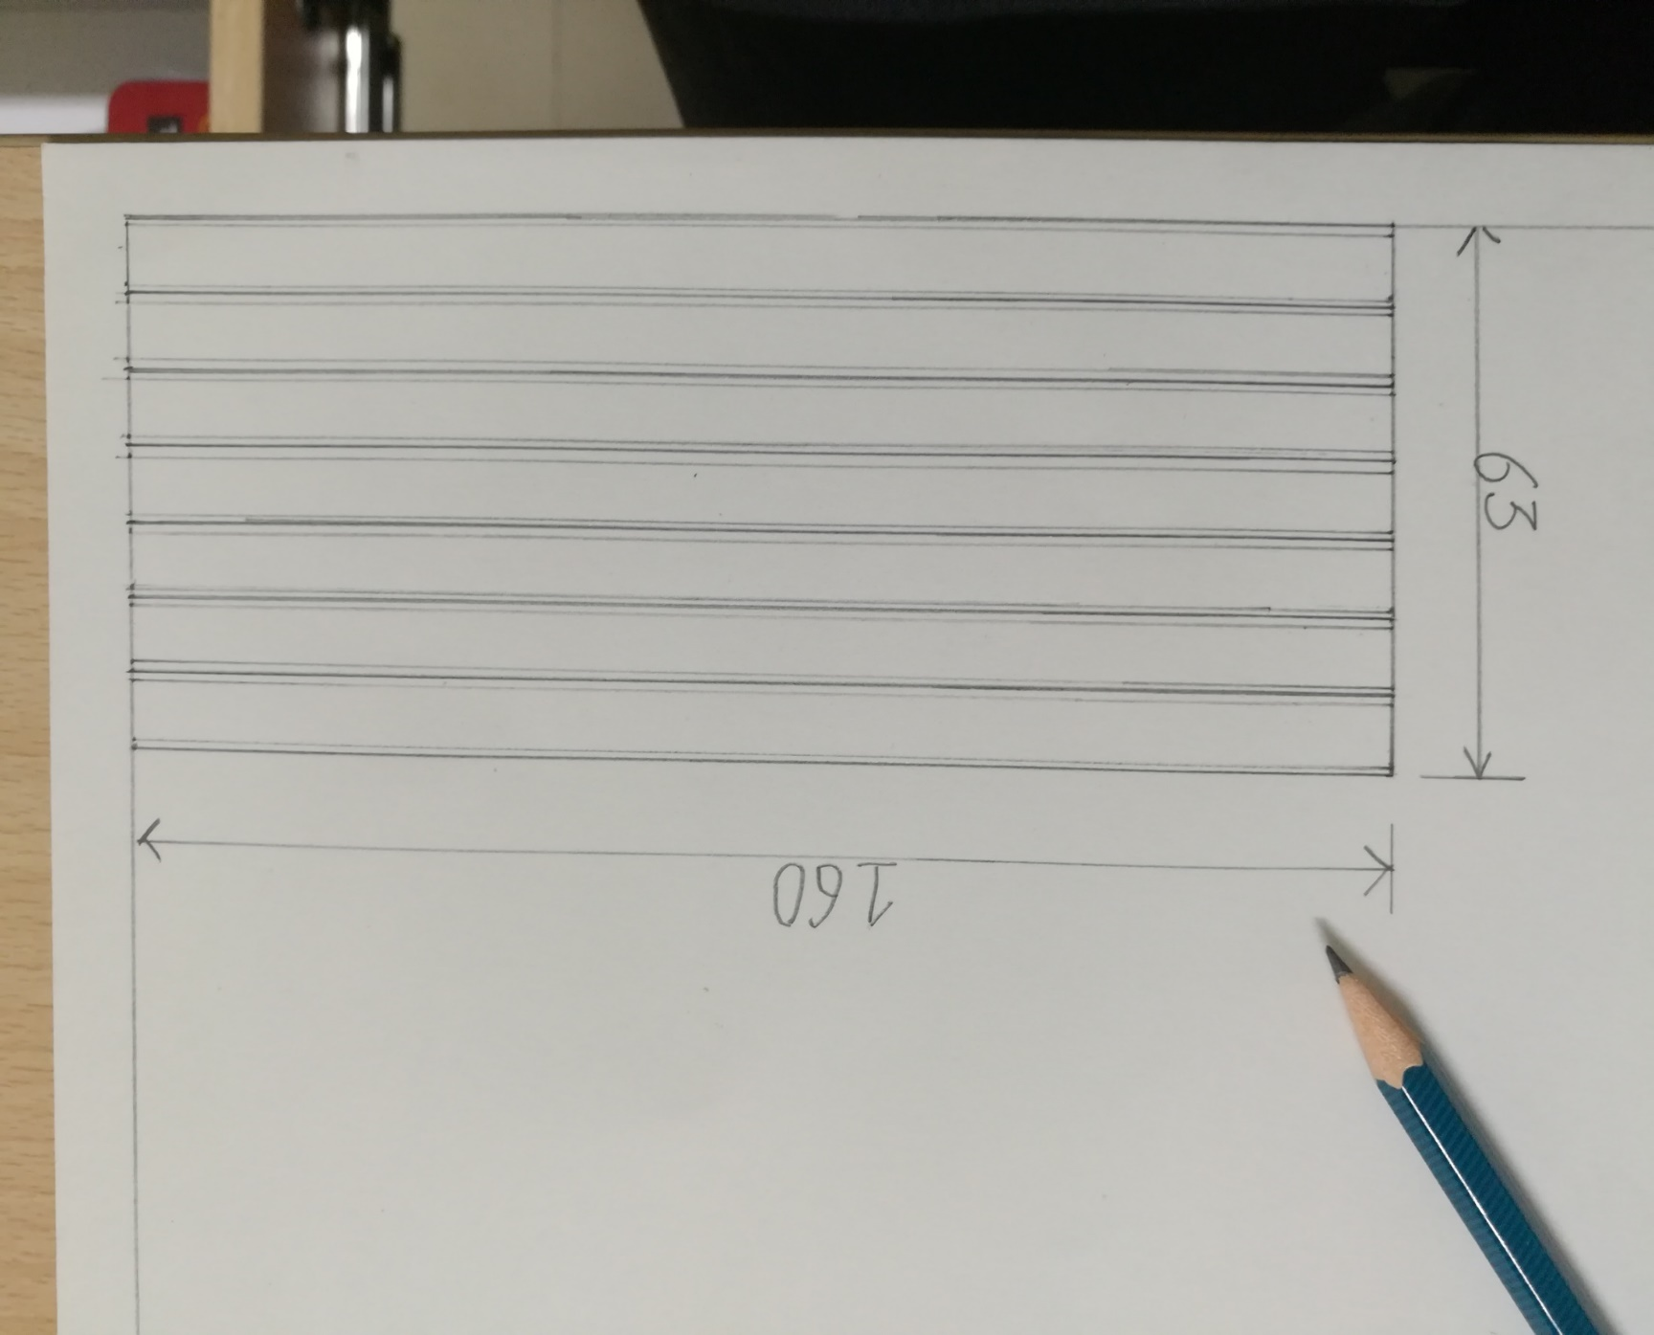
Sheet Layout
Title block
Division in 7 horizontal strips of 9 mm thickness
Dark lines and lighter lines

Slide 6
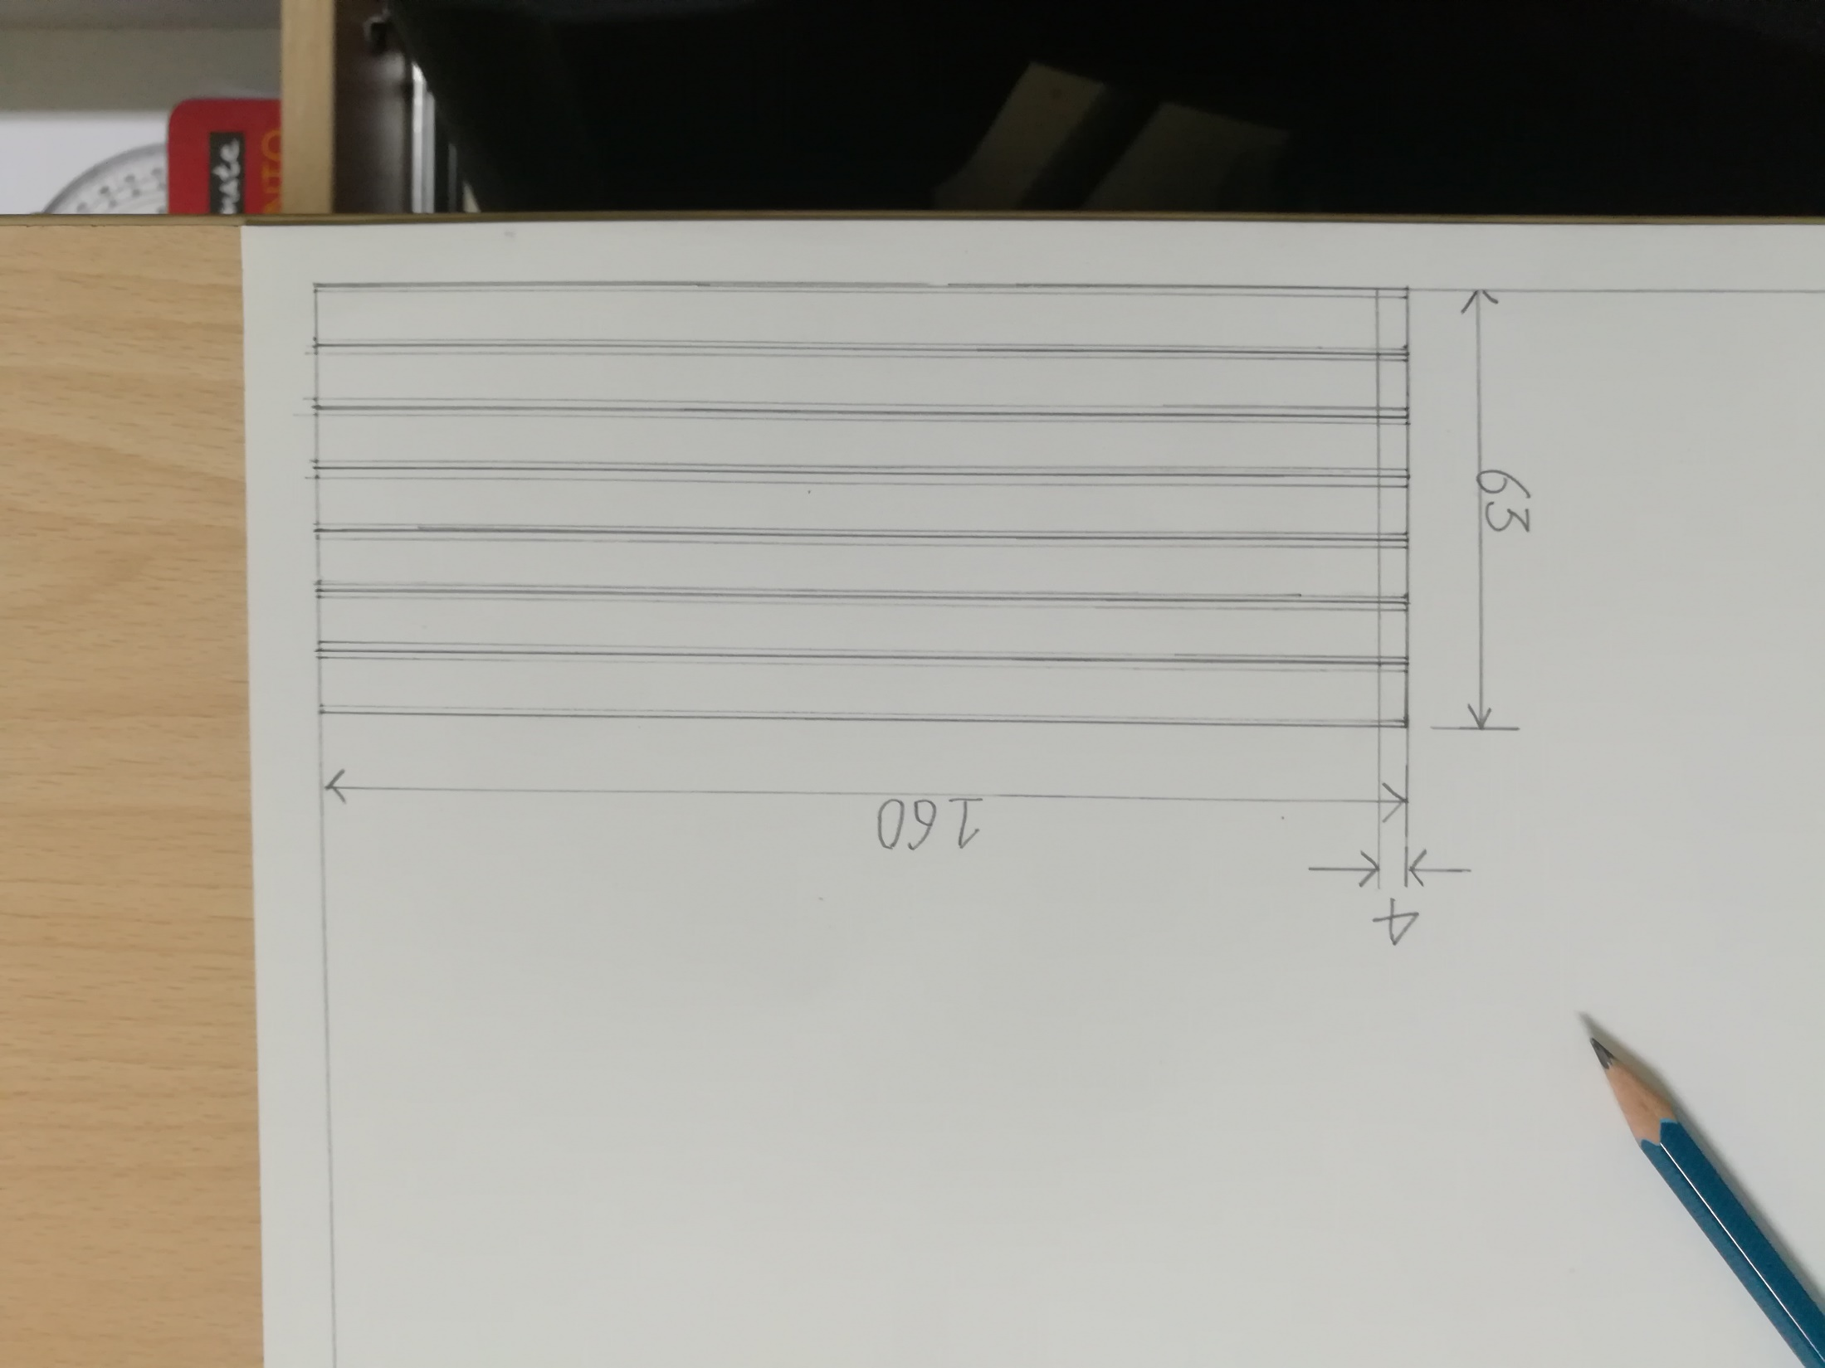
Sheet Layout
Title block
Division in 7 horizontal strips of 9 mm thickness
Dark lines and lighter lines
Leave 4 mm space at the left, then commence writing.

Slide 7
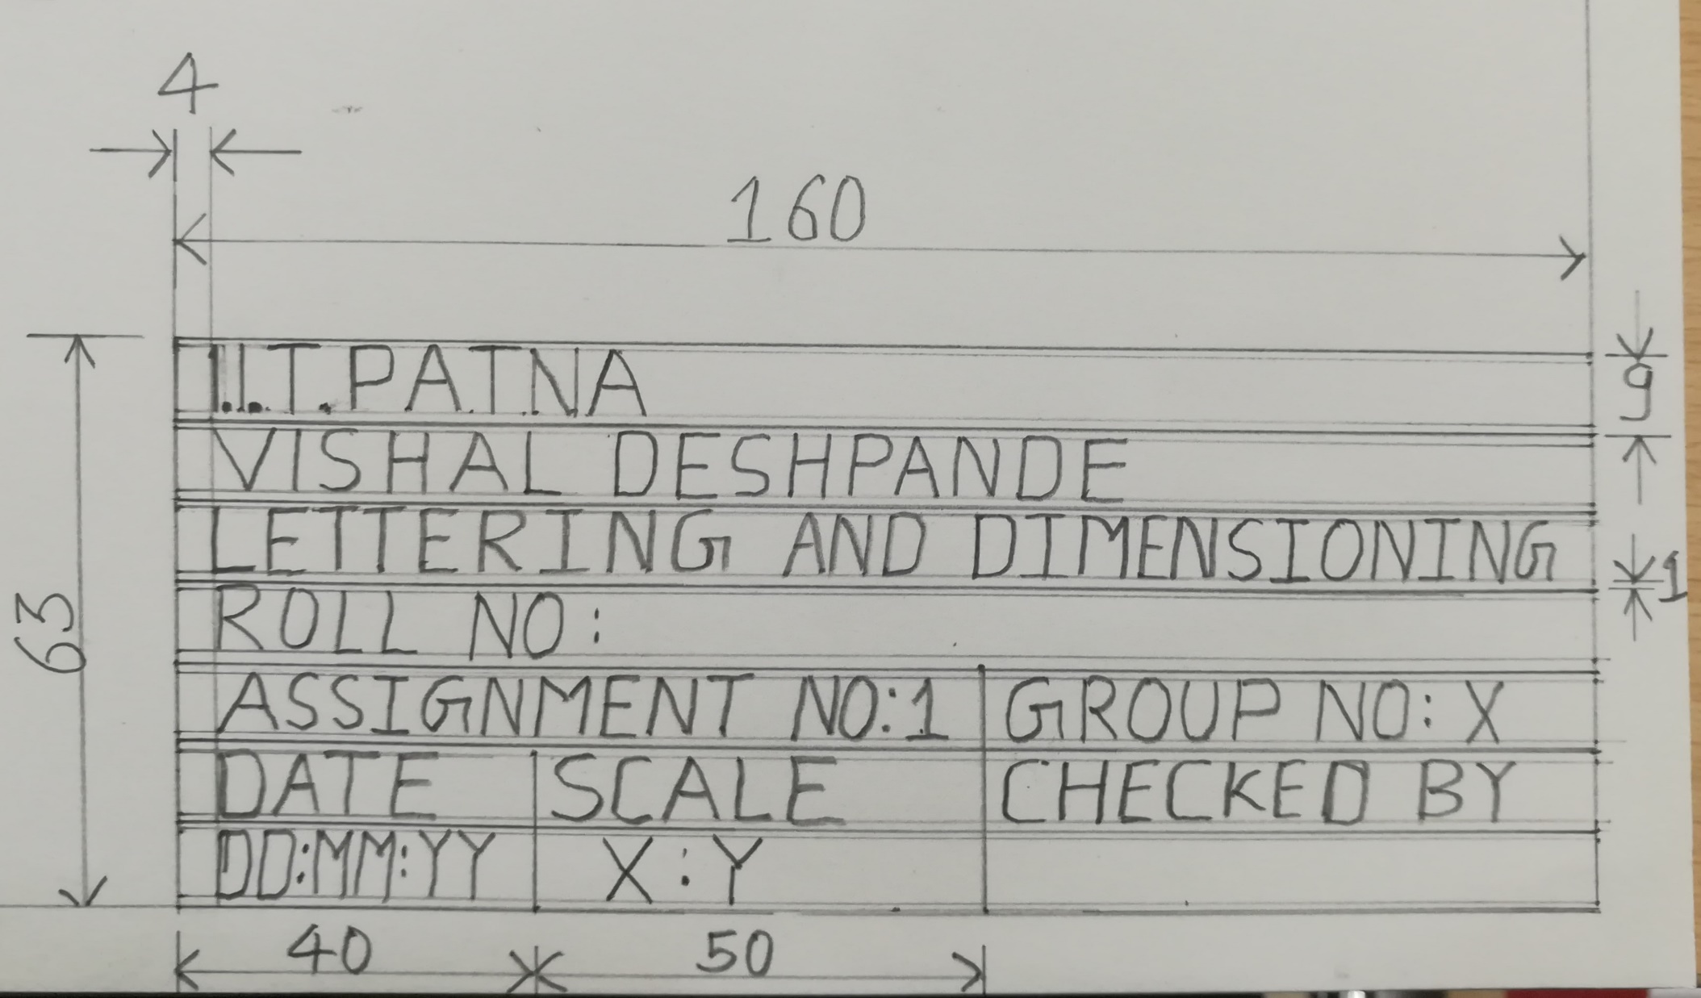
Title block

Slide 8
LETTERING
Writing text on a drawing (e.g. titles, dimensions, scales) using letters which can be alphabets, numerals, symbols or punctuation marks to convey detailed information.
Features of Lettering
Legibility, uniformity, ease, rapidity of execution and reproducibility
No ornamental or artistic and cursive style of letter
Letters should be distinguishable from each other in order to avoid any confusion even in case of slight mutilations
Standard followed
IS 9609 (Part 0): 2001 & SP46: 2003 (lettering for technical drawings). This BIS standard is based on ISO 3098-0: 1997

Slide 9
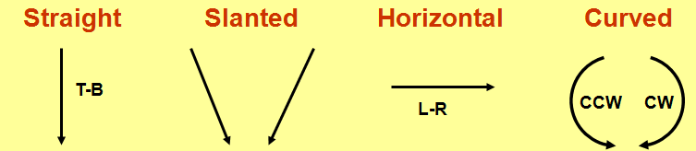
Types of Lettering
Single stroke - Thickness of the line of the letter should be such as is obtained in one stroke of the pencil.
Does not mean that the letter should be made in one stroke without lifting the pencil.
BIS (SP46:2003) - Gives dimensions for lettering & types
Type A - Height of capital letter is divided into 14 parts
Type B – Height of capital letter is divided into 10 parts
Both types can be Vertical or Inclined at 75˚ to the horizontal
Line Width of Type A ˂ Type B
Double stroke- When more thickness is given to single stroke letters, it is known as double stroke or gothic letters.
Basic Strokes

Slide 10
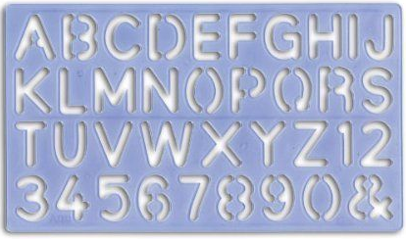
A lettering template

Slide 11
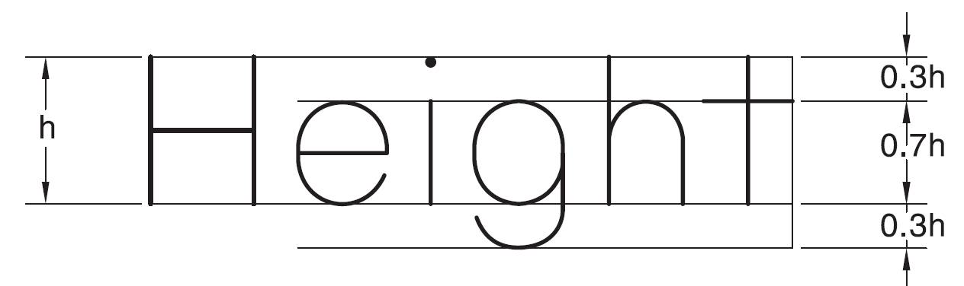
Height and width of letters
Examples
“I” letter
“A” letter
BIS (SP 46: 2003) has recommended the heights of letters as: 1.8, 2.5, 3.5, 5, 7, 10, 14 & 20 mm
“B” letter
4
5
1
1
2
1
Sl. no | Items on a drawing | Size (mm)
1 | Name of the company | 10, 14, 20
2 | Drawing numbers, letters denoting section planes | 10,14
3 | Title of the drawing | 7, 10
4 | Sub- titles & Headings | 5, 7
5 | Dimensioning, notes, schedules & material lists | 3.5, 7
6 | Alteration entries and tolerances | 3.5
3
6
3
2
.
Total height of lowercase letters equals that of capital letters.
The height-to-width ratio for letters varies between 7 : 5 or 7 : 6

Slide 12
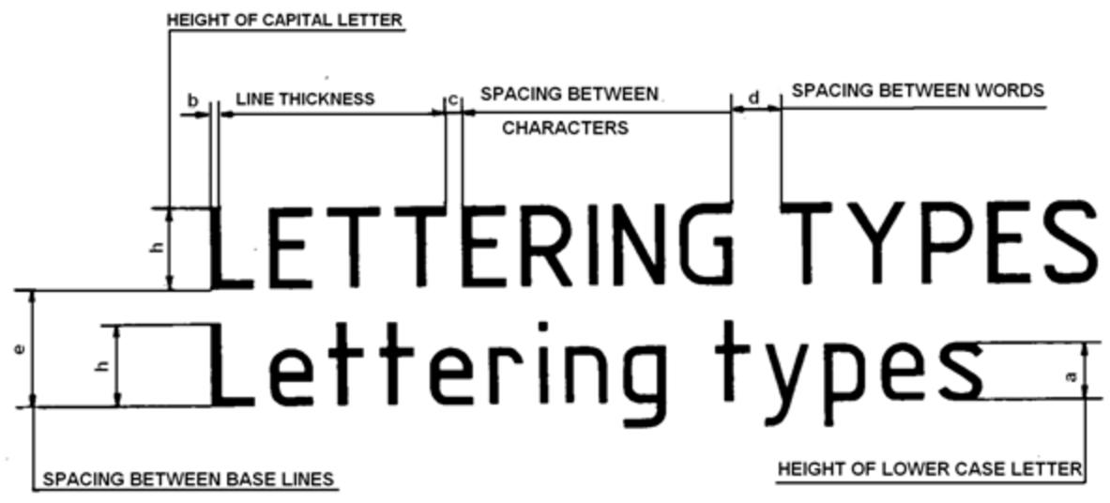
A & B type
Lettering
BIS (SP46: 2003)
Specifications | Type | Value | Size (mm)
Capital letter height | A | h | 2.5 | 3.5 | 5 | 7 | 10 | 14 | 20
 | B | h | 2.5 | 3.5 | 5 | 7 | 10 | 14 | 20
Lowercase letter height | A | a=(5/7)h | - | 2.5 | 3.5 | 5 | 7 | 10 | 14
 | B | a=(7/10)h | - | 2.5 | 3.5 | 5 | 7 | 10 | 14
Thickness of lines | A | b=(1/14)h | .18 | .25 | .35 | .5 | .7 | 1 | 1.4
 | B | b=(1/10)h | .25 | .35 | .5 | .7 | 1 | 1.4 | 2
Spacing between characters | A | c=(1/7)h | .35 | .5 | .7 | 1 | 1.4 | 2 | 2.8
 | B | c=(1/5)h | .5 | .7 | 1 | 1.4 | 2 | 2.8 | 4
Minimum spacing between words | A | d=(3/7)h | 1.05 | 1.5 | 2.1 | 3 | 4.2 | 6 | 8.4
 | B | d=(3/5)h | 1.5 | 2.1 | 3 | 4.2 | 6 | 8.4 | 12
Minimum spacing between baselines | A | e=(10/7)h | 3.5 | 5 | 7 | 10 | 14 | 20 | 28
 | B | e=(7/5)h | 3.5 | 5 | 7 | 10 | 14 | 20 | 28

Slide 13
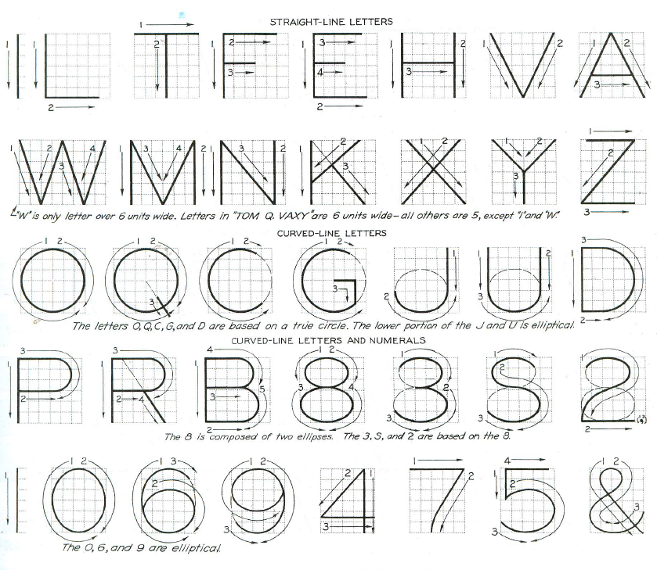
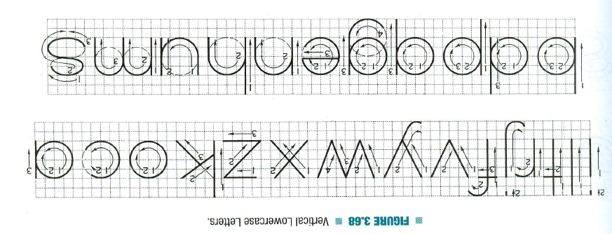
Vertical Capital Letters and Numerical
Vertical Lowercase Letters

Slide 14
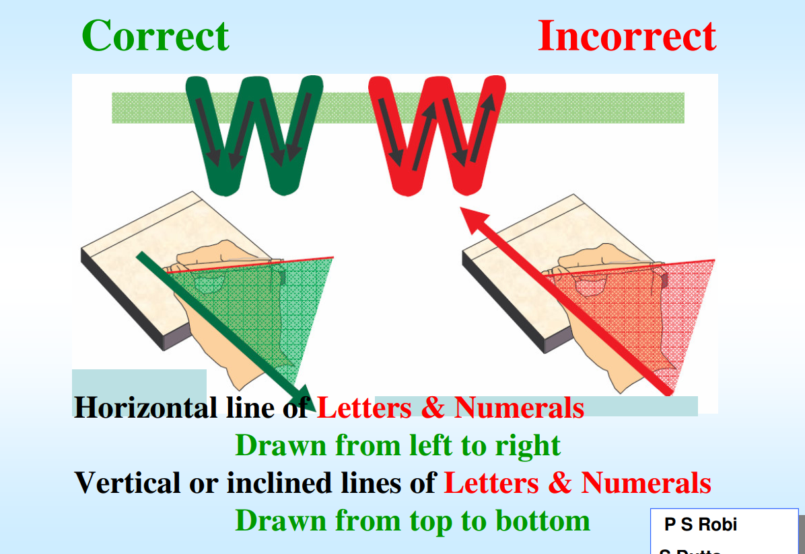

Slide 15
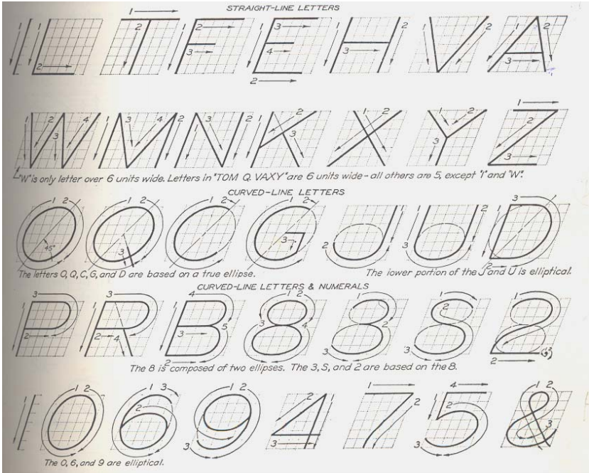
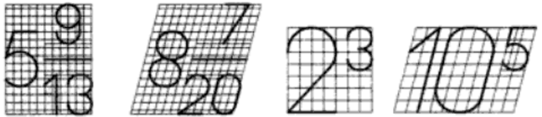
Fraction & Indices lettering
Height of numerator and denominator = 3/4th of height of non-fractioned number
Spacing between division bar and numerator or denominator should be such that the total height of fraction will be twice of that of non-fractioned number
Inclined Capital Letters
At 75˚
The height of index is half of height of a base letter

Slide 16
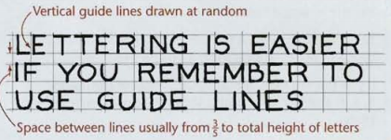
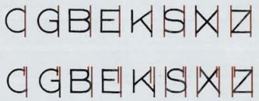
Few Tips
If you put the central horizontal strokes of the letters B, E, F, and H at mid-height, they will appear to be below center. To overcome this optical illusion, draw the strokes B, E, F, and H slightly above the center as you letter, keeping letters uniform, as in the second example of fig(right below).
Use extremely light horizontal guidelines to keep letter height uniform as shown in Figure (left above). Do not use vertical guidelines to space the distance from one letter to the next within a word or sentence . This should he done by eye while lettering.
Some combinations, such as LT and VA, may have to be slightly closer than other letters to look correctly spaced. In some cases the width of a letter may be decreased slightly. In typesetting, pairs of letters that need to be spaced more closely to appear correctly are called kerned pairs.

Slide 17
How to begin your drawing?
Clean the drawing board and all the drawing instruments using duster.
Fix the drawing sheet.
Draw border lines using HB pencil.
Complete the title box using HB pencil.
Plan spacing of drawings b/n two problems/views beforehand.
Print the problem number on the left top and then commence the drawing work.

Slide 18
Keeping drawing clean – a must
Never sharpen pencils over drawing.
Clean pencil point with a soft cloth after sharpening.
Keep drawing instruments clean.
Rest hands on drawing instruments as much as possible – to avoid smearing the graphite on the drawing.
When darkening lines – try to work from the top of the drawing to the bottom, and from left to the right across the drawing.
Use brush to remove eraser particles. Never use hands.
Always use appropriate drawing pencils.

Slide 19
Units of Measurement
International systems of units (SI) – which is based on the meter.
Millimeter (mm) - The common SI unit of measure on engineering drawing.
Individual identification of linear units is not required if all dimensions on a drawing are in the same unit (mm).
The drawing shall however contain a note: ALL DIMENSIONS ARE IN MM. (Bottom left corner outside the title box)

Slide 20
Dimensioning
Indicating on a drawing, the size of the object and other details essential for its construction and function, using lines, numerals, symbols, notes, etc.
Extension line – a thin, solid line perpendicular to a dimension line, indicating which feature is associated with the dimension.
Visible gap – there should be a visible gap of 1.5 mm between the feature’s corners and the end of the extension line.

Slide 21
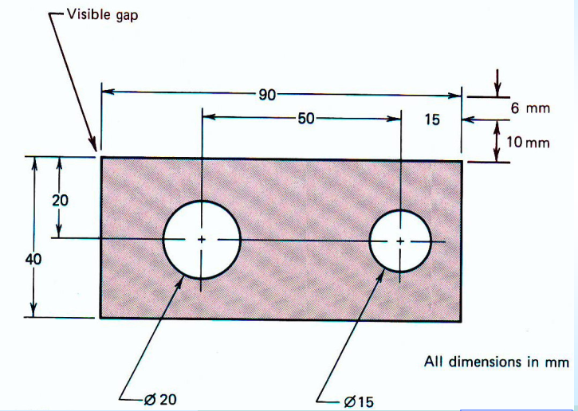

Slide 22
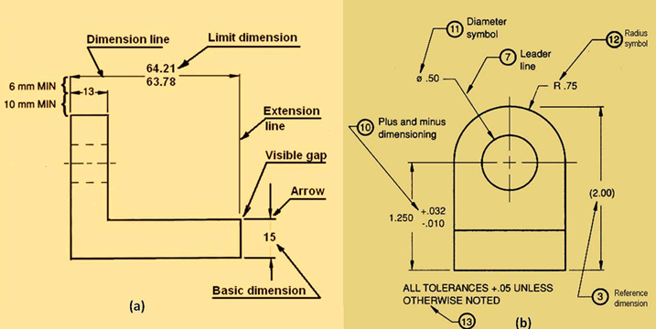
Important elements of dimensioning

Slide 23
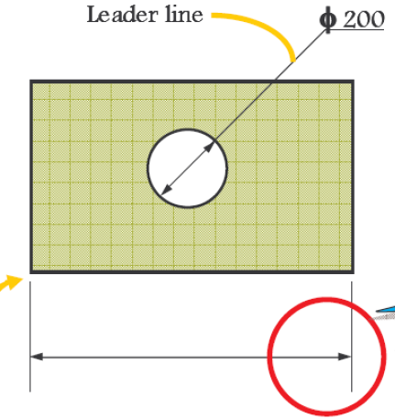
Dimensioning
Most convenient unit of length is millimeter.
Angles are shown in degree
Extension line
Dimension line
Leader line
Arrow heads
Dimensions

Slide 24
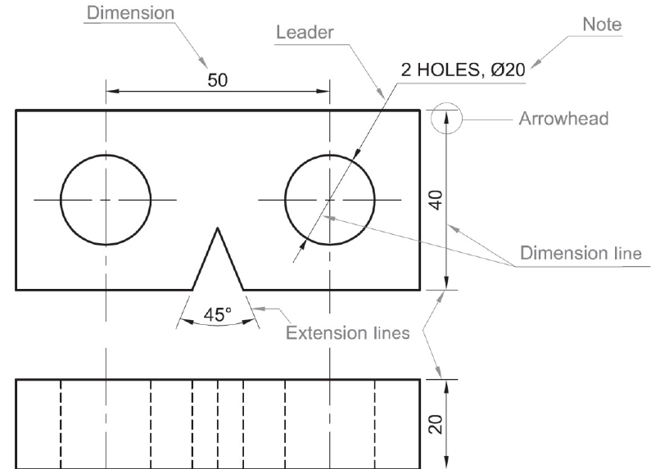
Dimensioning: Example

Slide 25
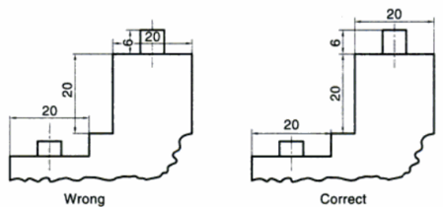
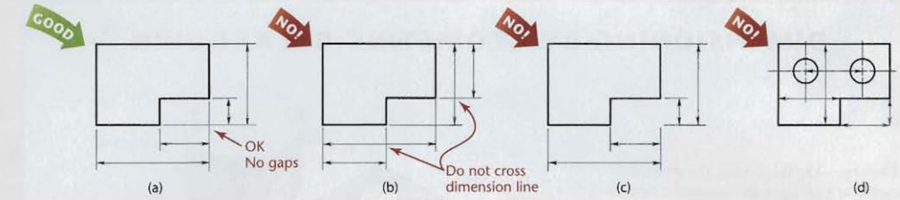
Best practices for dimension & extension lines
The shorter dimensions are nearest to the object outline.
Dimension lines should not cross extension lines as in Figure (b), which results from placing the shorter dimensions outside. Note that it is perfectly satisfactory to cross extension lines (Figure a), but they should not be shortened (Figure c).
Dimension lines should not cross each other & any other lines of the object. However extension lines can cross both (fig 1).
A dimension line should never coincide with or extend from any line of the drawing (Figure d).
Fig 1

Slide 26
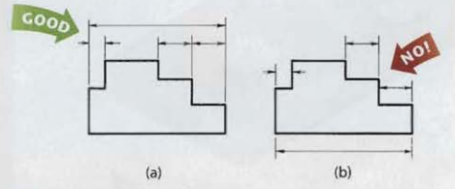
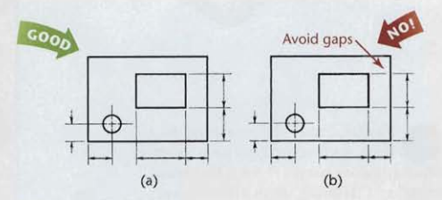
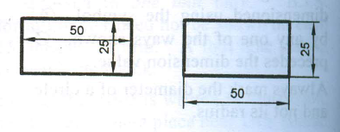
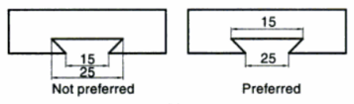
Best practices for dimension & extension lines
Dimensions should be lined up and grouped together as much as possible, as in Figure 2a, and not as in Figure 2b.
In some cases, extension lines and center-lines must cross visible lines of the object (Figure 3a). When this occurs, gaps should not be left in the lines (Figure 3b).
Fig 2
Fig 3
Dimensions should be placed outside the views (a). Placed inside if more clear and readable (b).

Slide 27
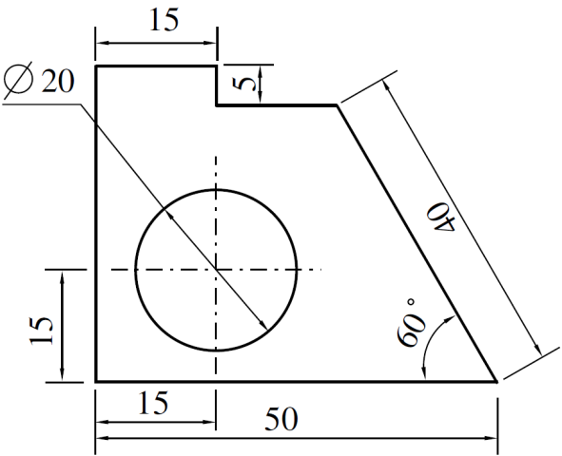
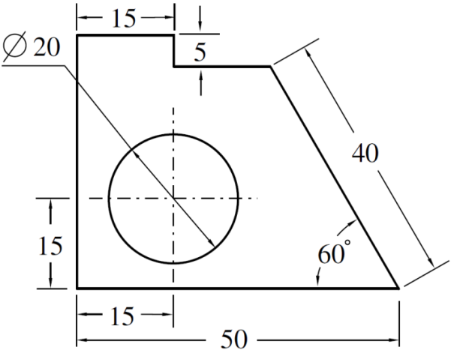
Systems of dimensioning
For placing the dimensions on the drawing, following systems can be adopted.
Aligned system | Unidirectional system
Dimensions are placed perpendicular to the dimension line. Horizontal and inclined dimensions can be read from the bottom of the drawing. Vertical dimensions can be read from the right-hand side of the drawing. All dimensions are placed above the midpoint of dimension lines. | Dimensions are placed vertically irrespective of dimension lines. All dimensions can be read from the bottom of the drawing. Horizontal dimensions are placed above the midpoint of dimension lines. Vertical and inclined dimensions are placed at the middle of dimension lines by breaking them.
Note
All the dimensions on a drawing must be shown using either Aligned System or Unidirectional System. Two systems should not be mixed on the same drawing.

Slide 28
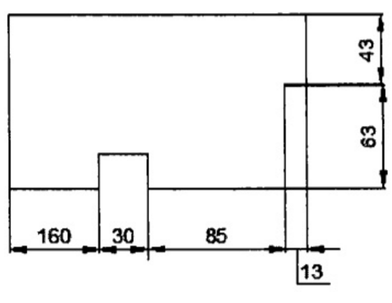
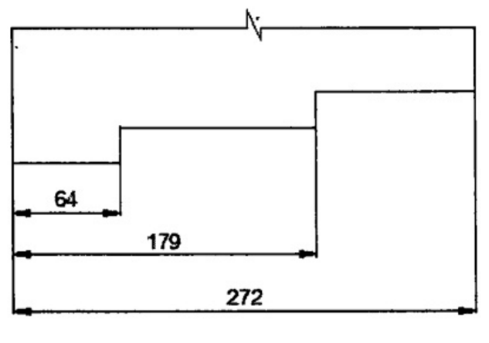
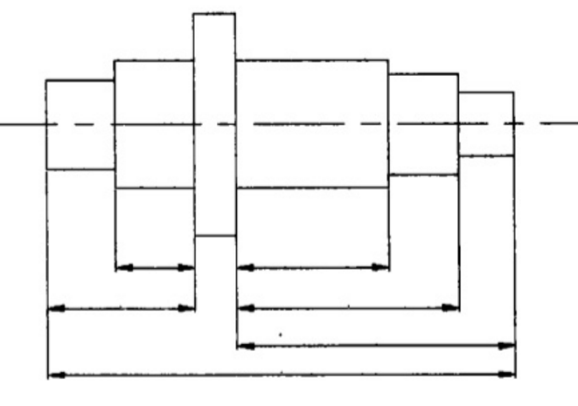
Arrangement of dimensions
Chain dimensioning | Parallel dimensioning | Combined dimensioning
All dimensions are aligned in such a way that an arrowhead of one dimension touches tip-to-tip the arrowhead of adjacent dimension. The overall dimension is placed outside the other smaller dimensions. | All dimensions are shown from a common reference line. All dimensions share a common extension line. This is adopted when dimensions have to be established from a particular datum surface. | Both the methods (chain & parallel) are used on the same drawing
 | Used where a number of dimensions have a common datum feature

Slide 29
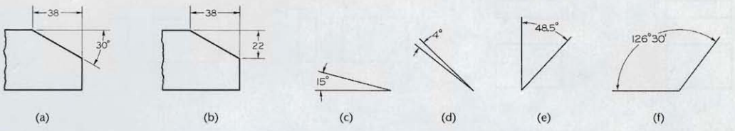
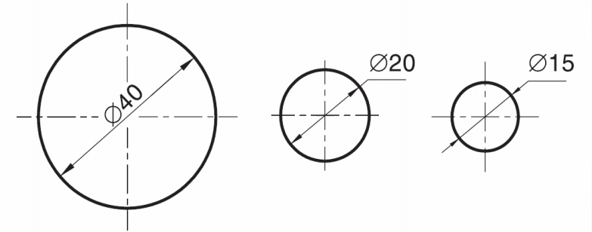
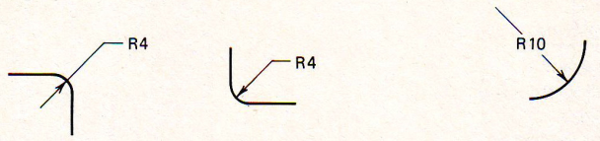
Dimensioning of angles
Dimensioning of circular features
A circle should be dimensioned by giving its diameter instead of radius. The dimension indicating a diameter should always be preceded by the symbol ø.
Dimensioning radii
Arcs of Circle Precede with ‘R’ to distinguish from length

Slide 30
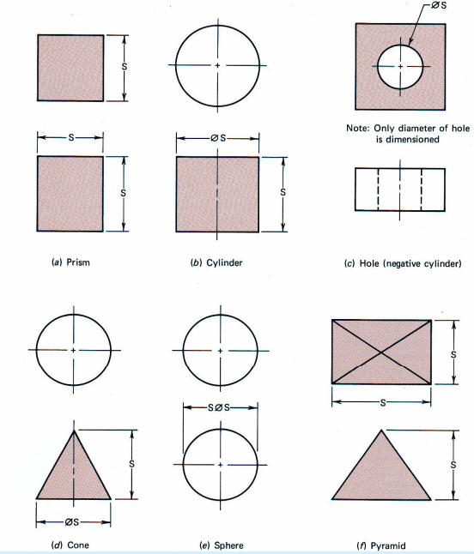
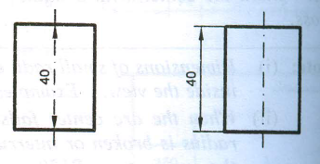
Center line(axis) itself shall not be used as a dimension line with arrowheads as its ends.
Wrong
Correct

Slide 31
Thank You

